Slide 1
Wholly inadequate Highly pragmatic introduction to Bayesian linear models in R
Ben Whalley, Jan 2018

Slide 2
Overview
What we typically ask
What we should ask instead
MCMC and the Metropolis algorithm
Stan and rstanarm
Using the posterior-predictive distribution
Better interpretation/summaries of results
Bayes Factors (briefly)

Slide 3
Conventional approach
Specify minimum effect of interest = X*
Sample size calculation with fixed alpha
Reject or fail-to-reject the null ^{(almost always zero effect)}
So we're asking: "how often would the effect be this large if the true effect were zero?"
Notes:
* in practice, people tend to specify the effect they saw in the literature leading to type M errors – see Gelman

Slide 4
What we actually want to know:
How big is the effect?
Probability the effect is substantively important?
Pr(Effect > X)
Pr(Effect >= X) / P(Effect < X)
Posterior(Effect > X) / Prior(Effect > X)
Probability the effect is zero?
Posterior(Effect == 0) / Prior(Effect == 0)
Bayesian approach lets us do this

Slide 5
Region of practical equivalence (± X)
± 2 points on (Hamilton Depression)
± 17.5% change in (Beck Depression Inventory)
± 5% bodyweight
…

Slide 6
Prior * Likelihood = Posterior
Evaluate this across the range of possible parameter values +
Sample in proportion to likelihood = Posterior distribution
Prior and Posterior distributions describes the probability of different parameter values (or estimates of an effect).

Slide 7
Priors for CBT
Which is more likely?
Effect of CBT is D = 50 (everyone gets better)
Effect of CBT is D = -50
Effect of CBT is D = 1
Effect of CBT is D = 0
Notes:
Try drawing this out on a plot

Slide 8
Priors for CBT
Notes:
Try drawing this out on a plot

Slide 9
Flat/uniform prior
Notes:
A flat prior

Slide 10
Normal(.5, 10)
Notes:
Normal M=.5, SD = 10

Slide 11
laplace(.5, 2)
Notes:
Laplace prior. Location = .5, spread = 2

Slide 12
Likelihood

Slide 13
Blue = sample, Red = population
Notes:
Blue = sample, Red = population

Slide 14
Green = other possible, but less likely parameter values
Notes:
The true mean and SD of outcome is .5 and .5, but other parameter values are also possible… The likelihood tells us the probability of the data, given the parameter value was true.

Slide 15
Markov Chain Monte Carlo (MCMC)
We want to calculate the probability distribution for each set of parameters, then multiply that by our prior
Maths hard/impossible possible for complex models
MCMC does it with magic
Trick is to jump around with some randomness, but spend more time on more likely parameters.
That is, spend time on parameters in proportion to how likely they are.

Slide 16
Good King Monte Carlo
From McElreath Rethinking
Notes:
10 islands in a ring
Different population
Want to visit them all fairly
Don't like planning!
Week by week decision

Slide 17
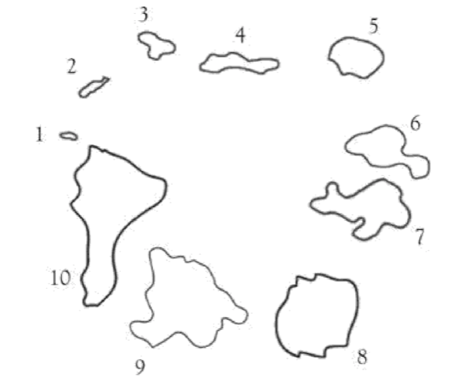
Each week
Decide direction by coin flip
Head = clockwise
This is the proposal
Counts out stones and shells
Stones= current island population
Shells = proposal population
Shells > stones … move to proposal
Equal… flip a coin
Shells < stones then
Remove as many stones as we have shells
Put shells + remaining stones in a hat
Pick one… shell = move to proposal
Notes:
Decide direction by coin flip
Head = clockwise
This is the proposal
Counts out:
Stones= current island population
Shells = proposal population
If shells > stones, move to proposal
If shells < stones then
Remove as many stones as we have shells
Put shells + remaining stones in a hat
Pick one; shell = move to proposal
(This is the Metropolis algorithm)

Slide 18
Examples of 3 cases…
A. On island with 8 people, proposal also has 8:
Coin flip to decide whether to move
B. Proposal island has more people on it: always move to proposal
C. On island with 8 people, proposal has 7
Pick from bag containing 7 shells and 1 stone
If shell, move to new

Slide 19
n_islands <- 10
propose <- function(island){
# flip a coin for clockwise/anticlockwise
proposal <- island + sample(c(-1,1), 1)
# make it wraparound
proposal <- proposal %% (n_islands+1)
return(proposal)
}

Slide 20
choose <- function(current, proposal){
if(proposal > current){
return(proposal)
}
# else pick from bay of stones/shells
bag <- c(
# these are the stones
rep(current, max(1, current-proposal)),
# these are the shells
rep(proposal, proposal)
)
return (sample(bag, 1))
}

Slide 21
island <- 1
draws <- vector()
for(i in 1:num_weeks){
draws[i] <- island
island <- choose(island, propose(island))
}

Slide 22
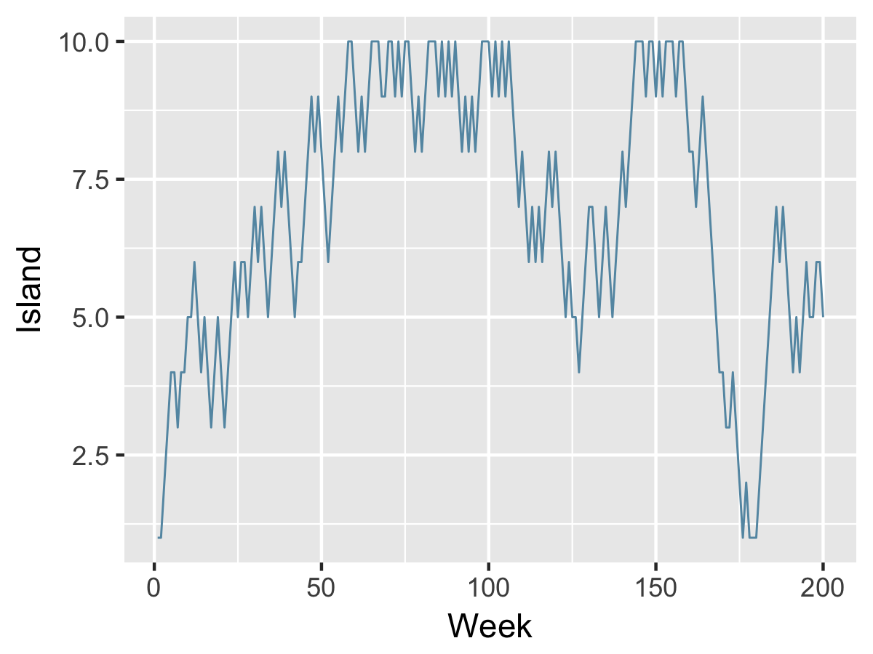

Slide 23
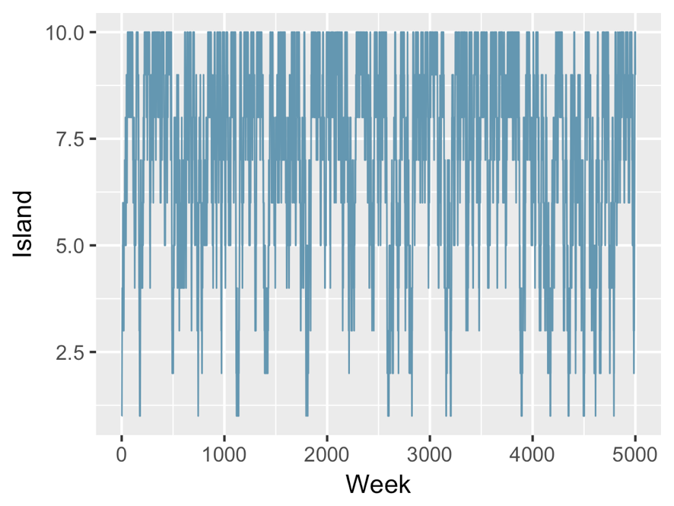

Slide 24
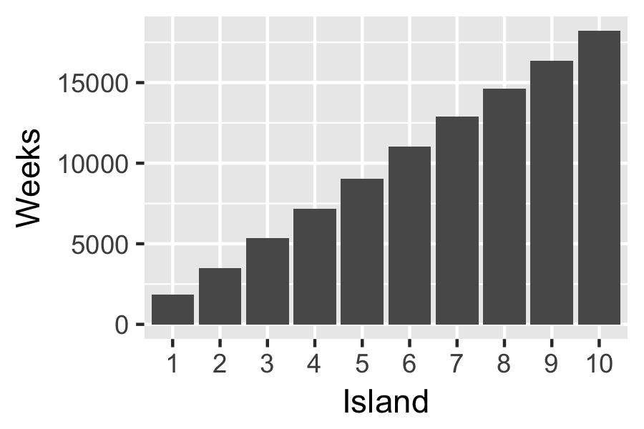

Slide 25
Island population Model Likelihood
In the analogy, population density = higher model likelihood
Proposal islands = alternative parameter values
Model likelihood = probability of data, given model parameters
The sample mean is a model for the population mean which has one parameter; assumes Gaussian etc.
We want to sample in proportion to Pr(data|parameters)
Pr( sample mean = 160cm| μ = 180)
Pr( sample mean = 160cm| μ = 160) <---- maximum likelihood
Pr( sample mean = 160cm| μ = 20)

Slide 26
This is the difference between groups. So == group parameter in oneway Anova
Green = other possible, but less likely parameter values
Notes:
The true mean and SD of outcome is .5 and .5, but other parameter values are also possible… The likelihood tells us the probability of the data, given the parameter value was true.

Slide 27
Stan is cool
Stan is a declarative model language and transpiler (to C++)
rstan is wrapper for running raw Stan code
rstanarm and brms take R model syntax ( y ~ A+B+A:B ) and write and run Stan for you
Most people could switch rstanarm or brms for lm, glm, aov, lmer etc.

Slide 28
FIT RCT Raw data (mean and SD) KG = Patient weight MI=Motivational interviewing FIT=Functional imagery training
For these examples I have thrown away 80% of the data… The effect was so large that all BF ~ Inf otherwise! Linda too efficient…

Slide 29
The model: Oneway Ancova
m1 <- lm(Followup ~ Baseline * group, data=df)
Or, to make it even simpler, a t-test:
lm(Followup ~ group, data=df)

Slide 30
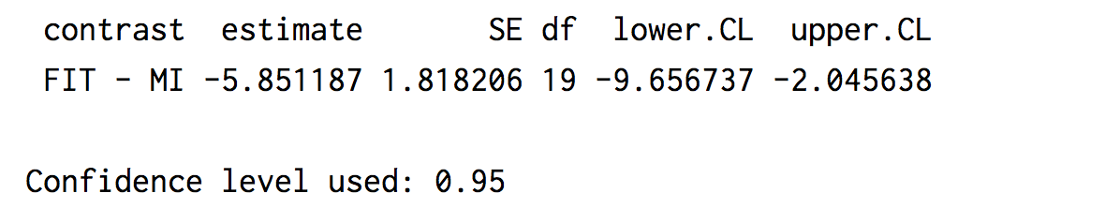
Oneway Ancova: Standard contrast
m1 <- lm(Followup ~ Baseline * group, data=df)
confint(
contrast(
lsmeans(m1, "group"),
trt.vs.ctrl.lsmc))

Slide 31
Again with MCMC in Stan
m1.stan <-
stan_glm(Followup ~ Baseline * group,
data = df)

Slide 32
rstanarm::
stan_lm(…)
stan_aov(…)
stan_glm(…)
stan_lmer(…)
I tend to use stan_glm or stan_lmer because explicitly specifying priors is simpler (if you want to do it at all).
Defaults sane, well considered, and actually work.
Notes:
For lm and aov you need to specify a prior for R²
Don't overthink it
Great model = .8
OK model = .5
Bad model = .2
Creates weakly informative normal priors for betas (autoscaled)
This is a good thing. Do you think P(beta = 1e100) == P(beta = 1) ???
If you have sensible amounts of data it won't matter
Sensitivity analysis

Slide 33
Convergence/traceplot
Notes:
Also check n_eff in summary(stanfit)
Run at least 5000 iterations for inference, from 3 chains, and check mcse error.

Slide 34
Example of poor mixing

Slide 35
Posterior predictions
No equivalent of lsmeans or contrasts
Extract posterior predictions with tidybayes::add_fitted_samples
Like fitted(), but for each sample in the MCMC chain
Predict for interesting values and… you have posterior distribution of the effect of interest
Notes:
Note, posterior_linpredict is the equivalent within rstanarm, but naming is confusing and predictions returned as a matrix not a df

Slide 36
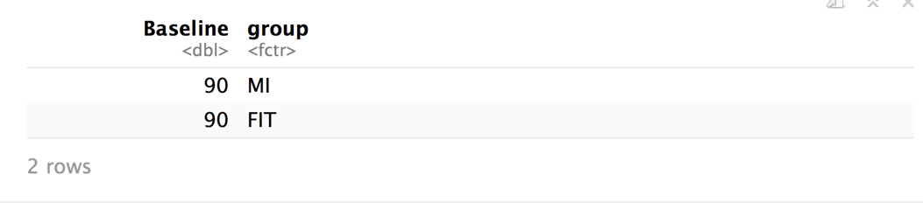
Predicting at means
newdata <-
expand.grid(Baseline=90,
group=c("MI", "FIT"))

Slide 37
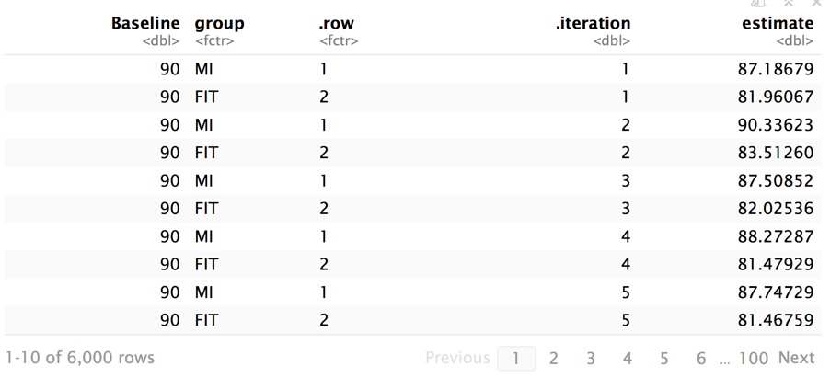
Processing MCMC samples/predictions
posterior_samples <-
tidybayes::fitted_samples(m1.stan, newdata)

Slide 38
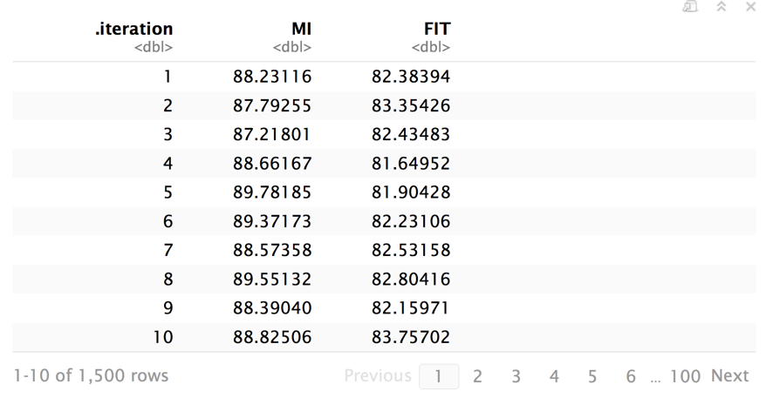
After reshaping wide by group…

Slide 39
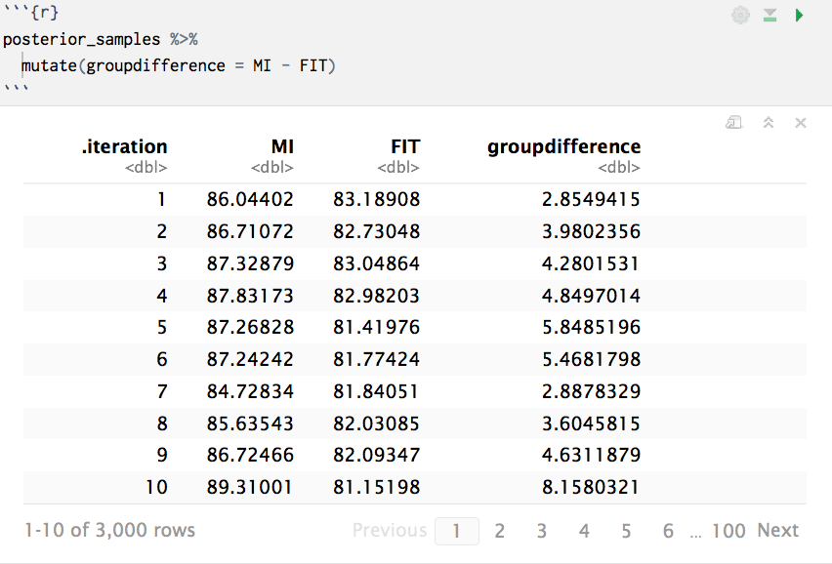
We can do arithmetic!

Slide 40
Posterior distribution of the effect
posterior_samples %>%
ggplot(aes(MI-FIT)) + geom_density()
This plot is the equivalent of the weeks spent on each island… except now the central tendency is the predictions made by the most likely sets of model parameters.

Slide 41
How much did we learn?
Notes:
To plot this, we can:
Sample from our priors (i.e. not using the data)
Sample from the posterior (ie. after data has been included)

Slide 42
Working with posterior predictions
Mean/median
Expectation vs. typical
Intervals
Percentile
Highest probability density intervals
Simple arithmetic
Notes:
posterior mean minimizes expected loss when the loss function is squared error and the posterior median minimizes expected absolute error

Slide 43
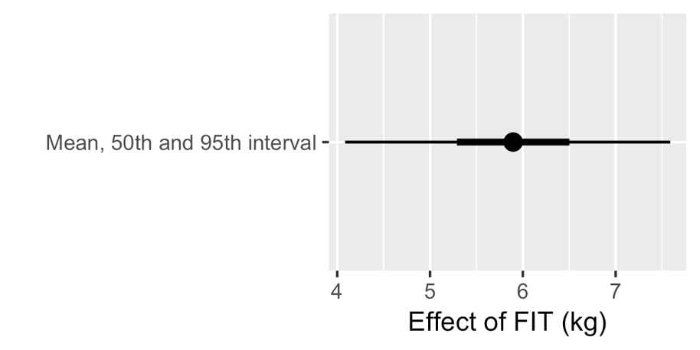
Mean and (percentile) intervals
posterior_samples %>% ggplot(aes("Mean/50th/95th", MI-FIT)) + stat_pointinterval(.prob = 0.95) + stat_pointinterval(.prob = 0.5)

Slide 44
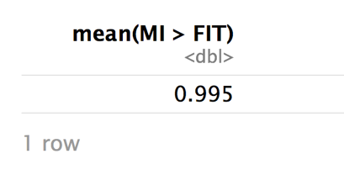
Probabilities (not 'p' values)
posterior_samples %>%
summarise(mean(MI > FIT))

Slide 45
Notes:
Can discuss this with patients… what is the likely benefit

Slide 46
FIT
MI

Slide 47
Bayes Factors
BF as a posterior 'evidence ratio':
P(A) / P(B)
posterior_samples %>%
summarise(mean(MI > FIT) / mean(MI <= FIT))
Can also think about comparing prior with posterior:
P(A==0|Prior) / P(A==0|Posterior)
For this type of point-null hypothesis use brms::hypothesis
Notes:
https://mvuorre.github.io/post/2017/bayes-factors-with-brms/
https://mvuorre.github.io/post/2017/bayes-is-bayes-isnt/

Slide 49
Reasons to bother
Meaningful intervals and p values
Random effects and complex variance
Regularization/prediction/overfitting

Slide 50
Other stuff
Installation (should just work now though on UoP machines)
Weirdnesses in BF (depending on priors)
Flat vs. 'Regularising' v.s. informative priors
Validation/Out of sample prediction
Error in fitted vs predicted

Slide 51
Pointers
Books
McElreath Rethinking
Kruschke
Doing Bayesian Data Analysis
T-test paper
Gelman DBA3 and http://andrewgelman.com
Packages (should be preinstalled on UoP machines now)
rstanarm
brms::brm and brms::hypothesis
tidybayes
bayesplot
Notes:
Kruschke, John. Doing Bayesian Data Analysis: A Tutorial with R, JAGS, and Stan. Academic Press, 2014.
Kruschke, John K. “Bayesian Assessment of Null Values Via Parameter Estimation and Model Comparison.” Perspectives on Psychological Science 6, no. 3 (May 2011): 299–312. https://doi.org/10.1177/1745691611406925.
———. “Bayesian Data Analysis.” Wiley Interdisciplinary Reviews: Cognitive Science 1, no. 5 (September 1, 2010): 658–76. https://doi.org/10.1002/wcs.72.
McElreath, Richard. Statistical Rethinking: A Bayesian Course with Examples in R and Stan. CRC Press, 2018.
Bürkner, Paul-Christian. Brms: Bayesian Regression Models Using Stan (version 2.0.1), 2017. https://cran.r-project.org/web/packages/brms/index.html.
Kay, Matthew. Tidybayes: Bayesian Analysis + Tidy Data + Geoms (R Package). R, 2018. https://github.com/mjskay/tidybayes.

